Slide 1


Unit 5: Lesson 17
What a party!

Slide 2


Slide 3
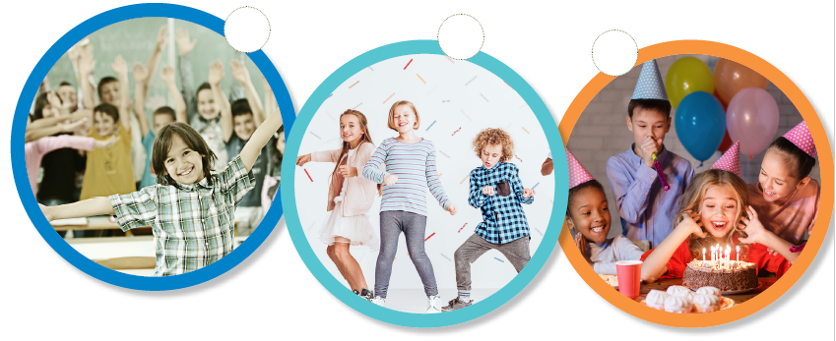
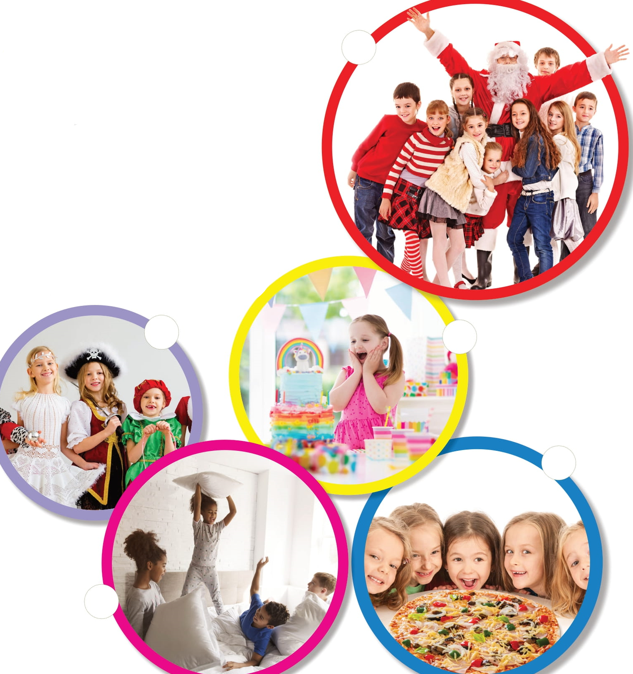

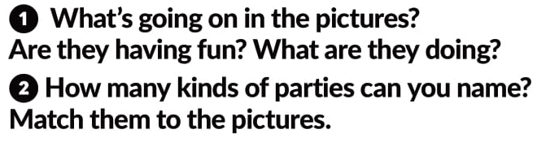
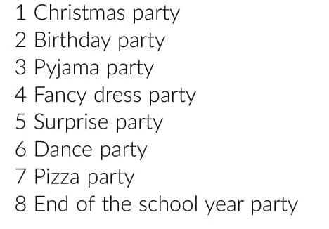
8
6
2
1
4
5
7
3

Slide 4


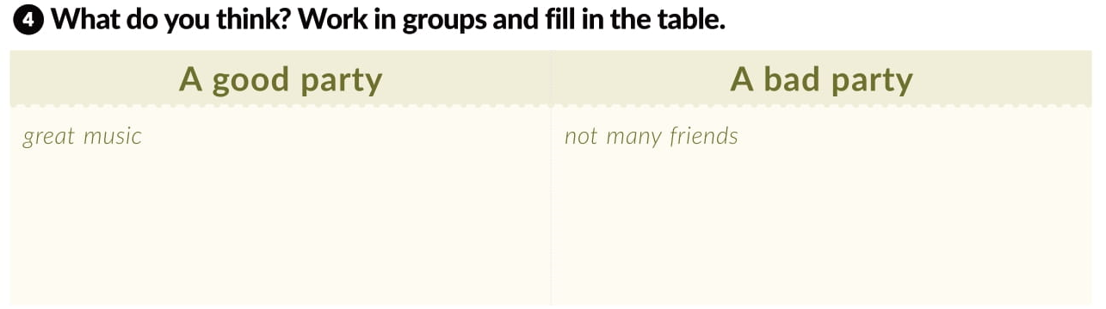

Slide 5
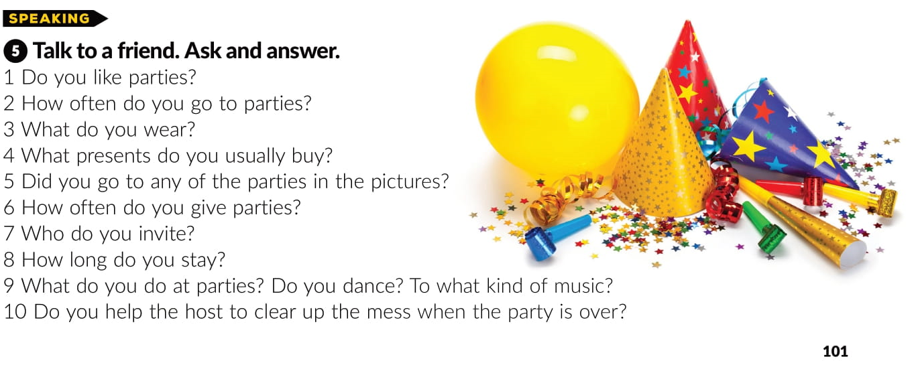

Slide 6

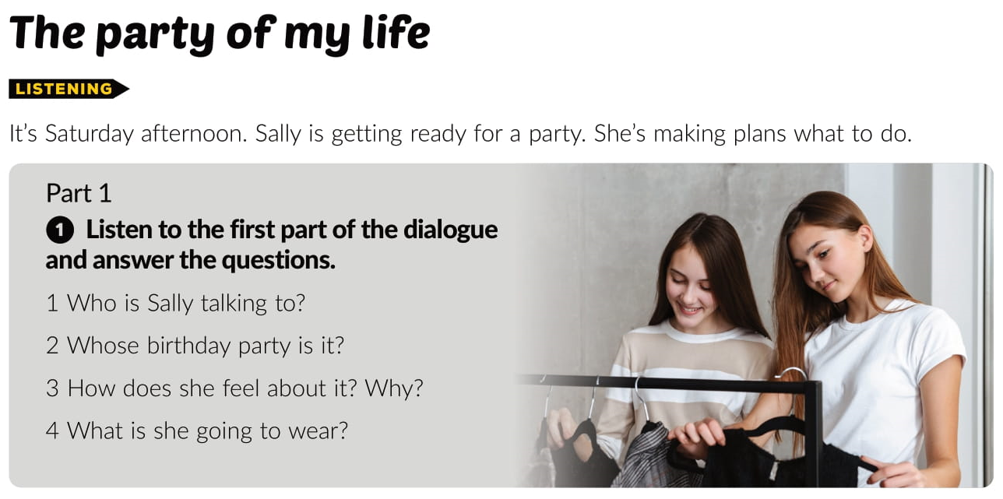
https://www.e-sfera.hr/dodatni-digitalni-sadrzaji/567fa25c-8fe3-4953-a09a-ae21b2a11271/assets/audio/26-track_26_what_a_party_part_1.mp3
Anne
David’s
Nervous, because she fancies David.
Jeans and T-shirt

Slide 7
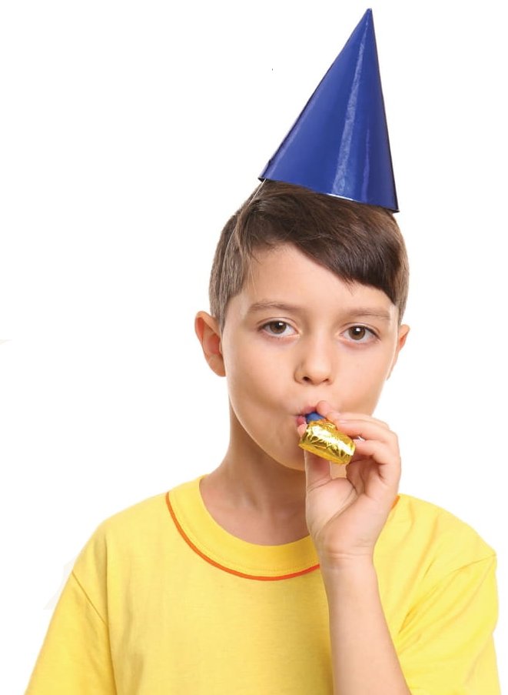
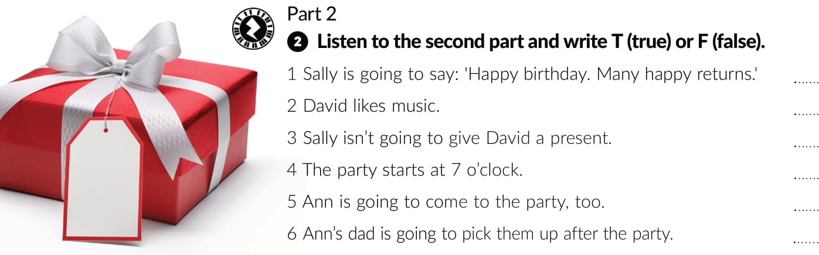
https://www.e-sfera.hr/dodatni-digitalni-sadrzaji/567fa25c-8fe3-4953-a09a-ae21b2a11271/assets/audio/26-track_26_what_a_party_part_2.mp3
T
T
F
F
T
F

Slide 8
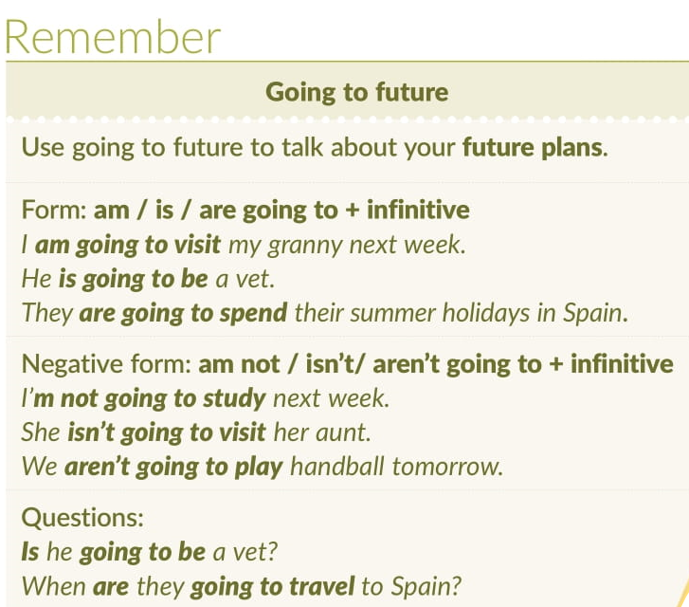

Slide 9
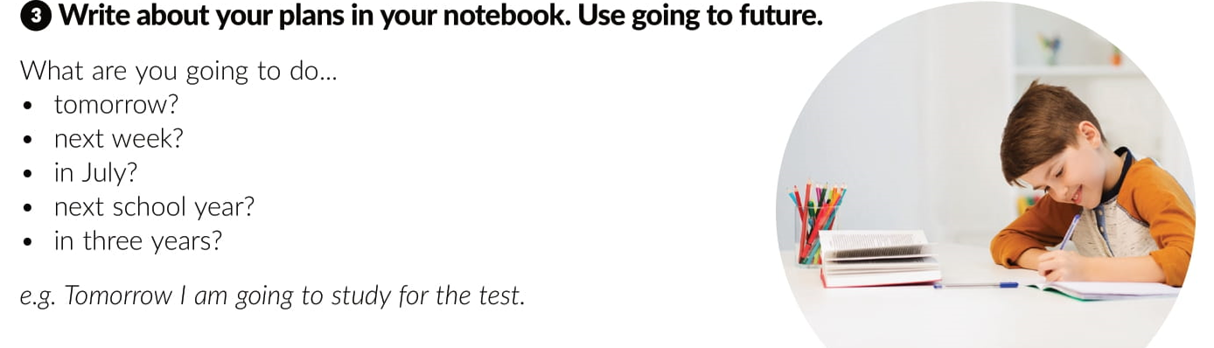

Slide 10
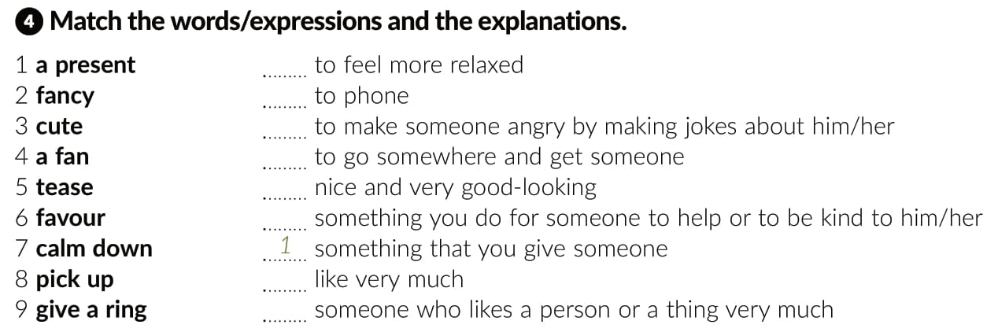
7
9
5
8
3
6
2
4

Slide 11
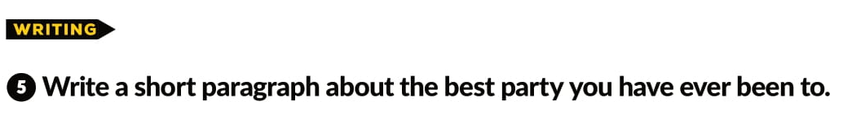
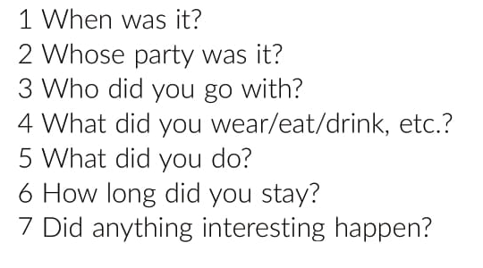

Slide 12
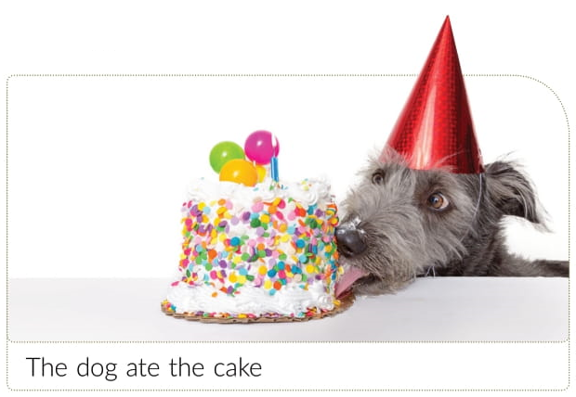

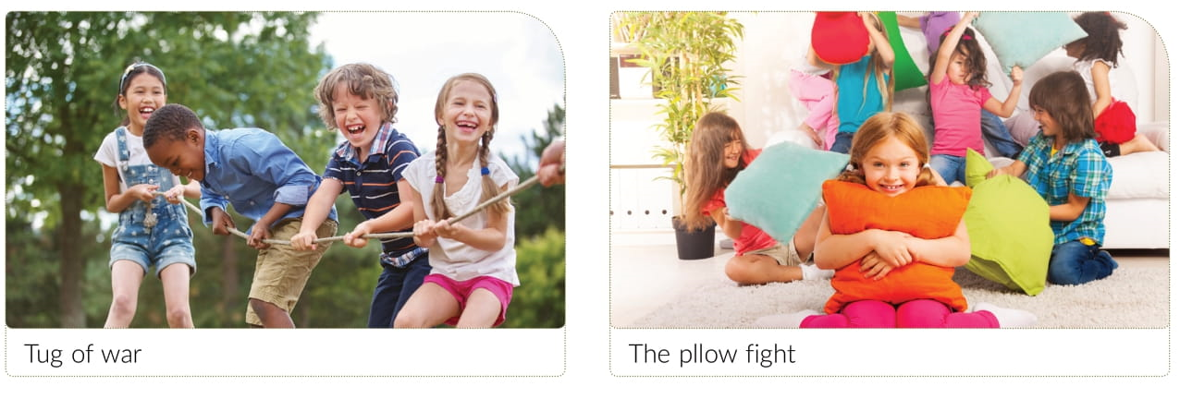

Slide 13
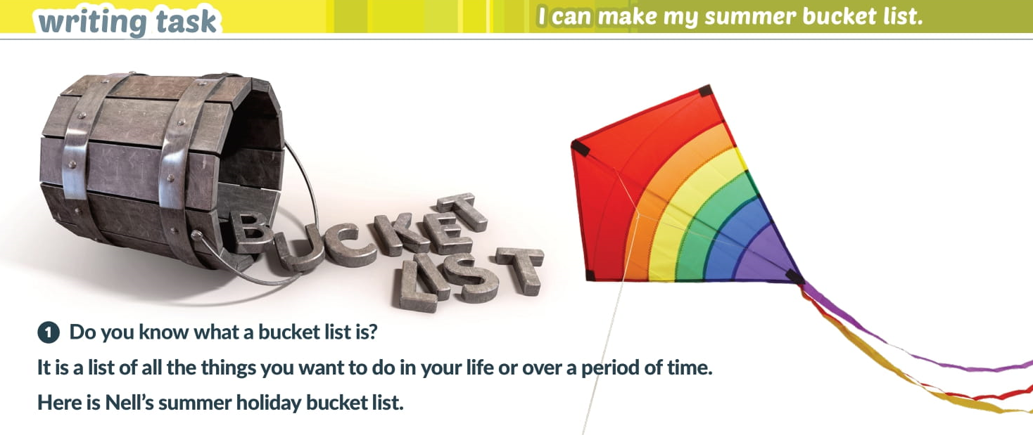

Slide 14
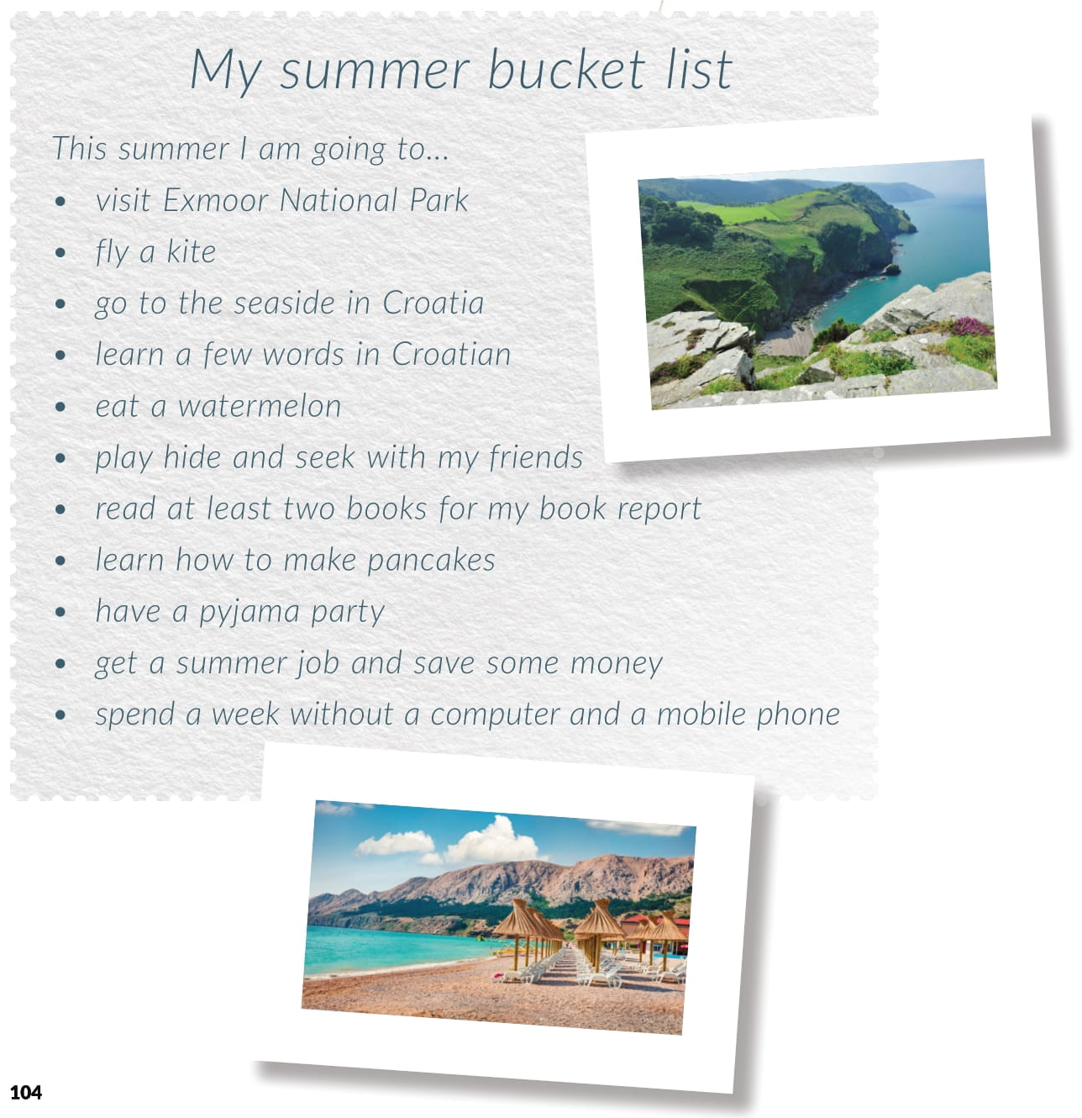

Slide 15

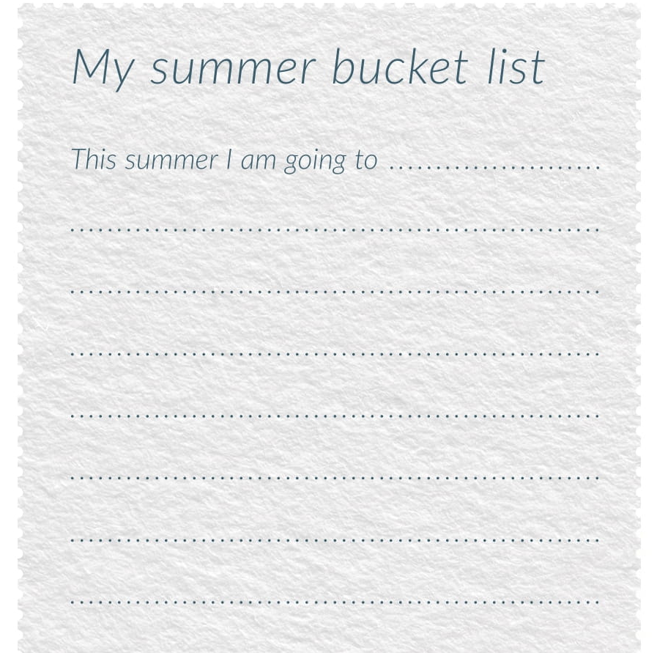
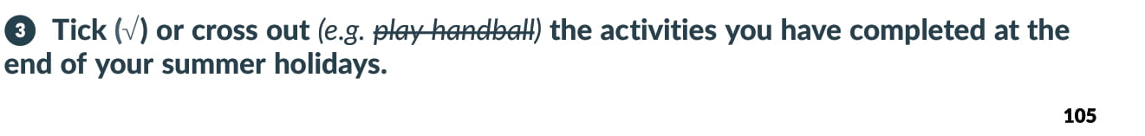

Slide 16
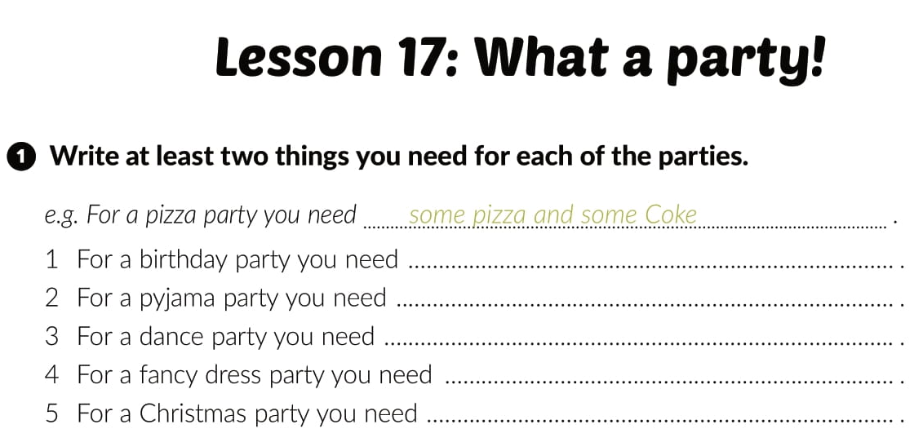
Workbook, page 79

Slide 17
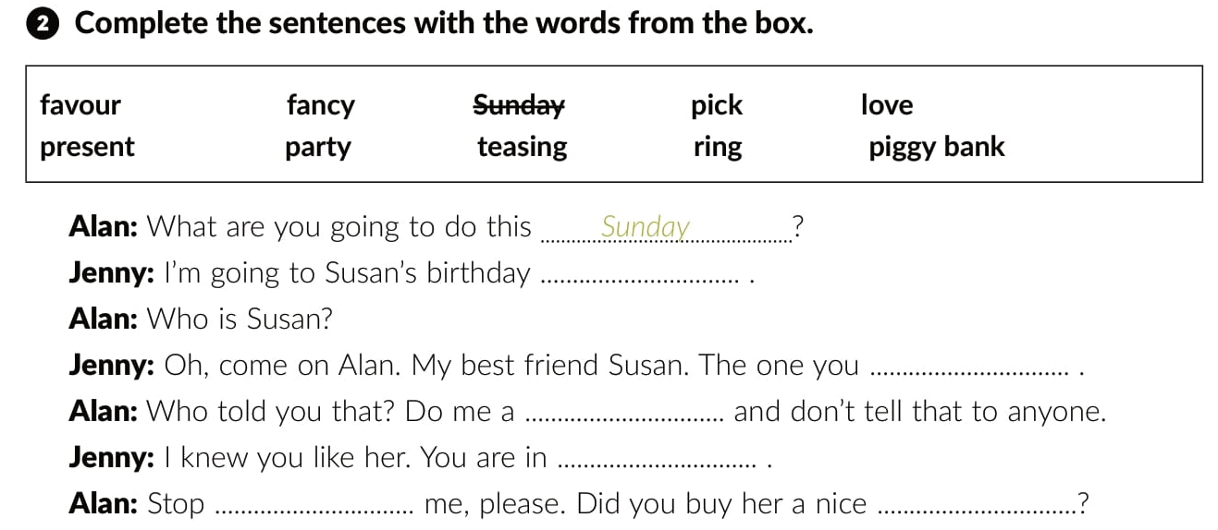
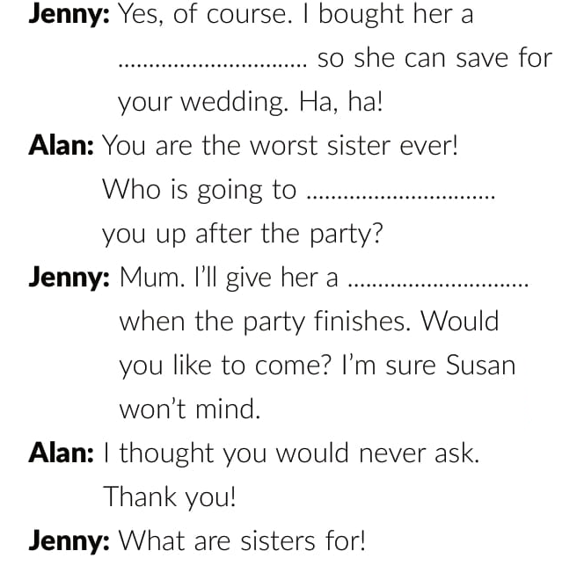
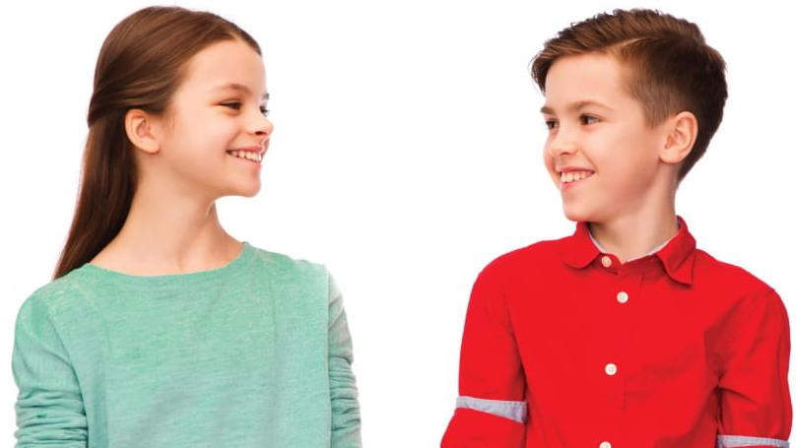
party
fancy
favour
piggy bank
love
teasing
present
pick
ring

Slide 18
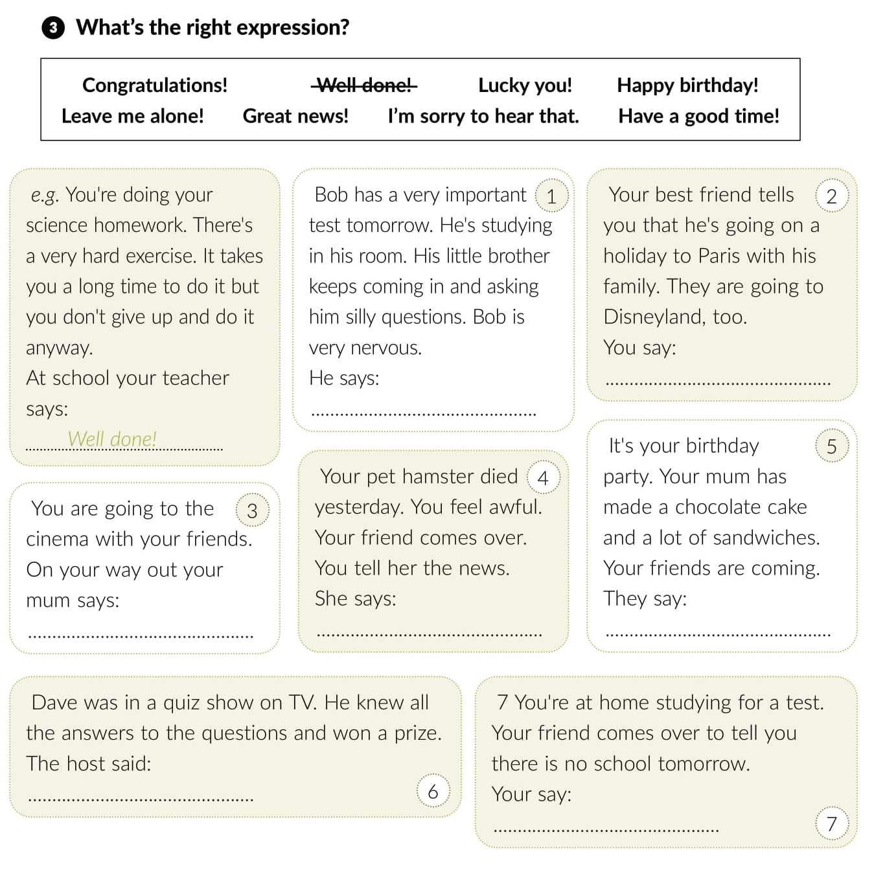
Lucky you!
Leave me alone!
Have a good time!
I’m sorry to hear that.
Happy birthay!
Congratulations!
Great news!

Slide 19
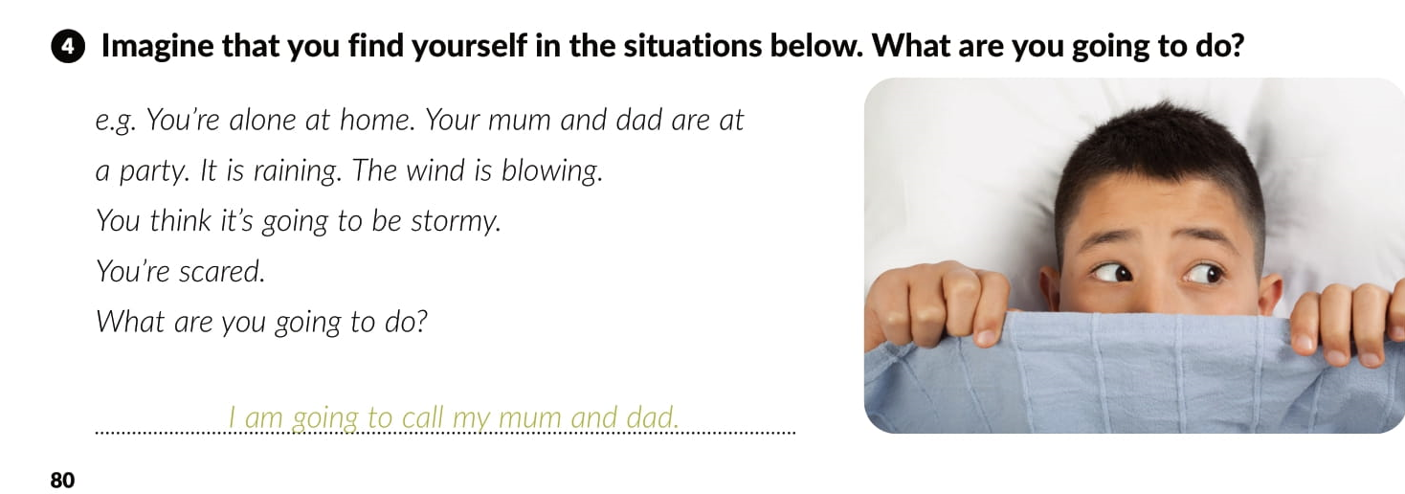

Slide 20
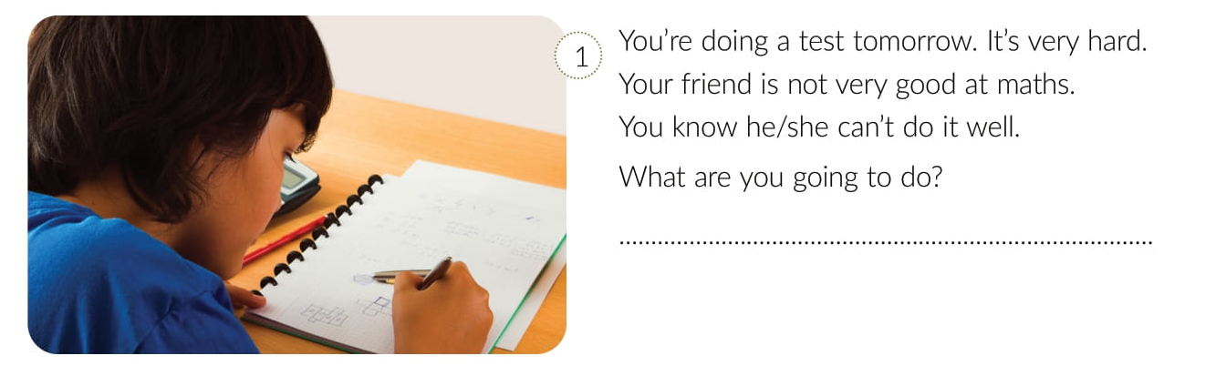
I am going to study with her.

Slide 21
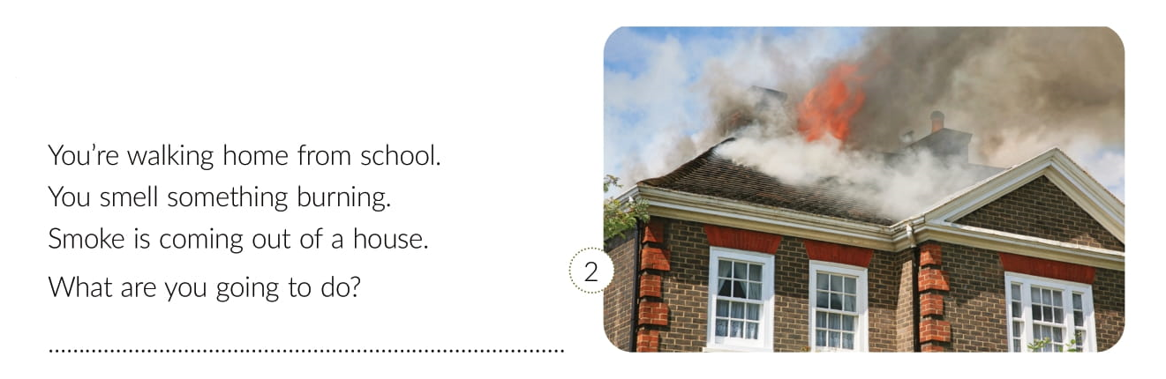
I am going to phone 112.

Slide 22
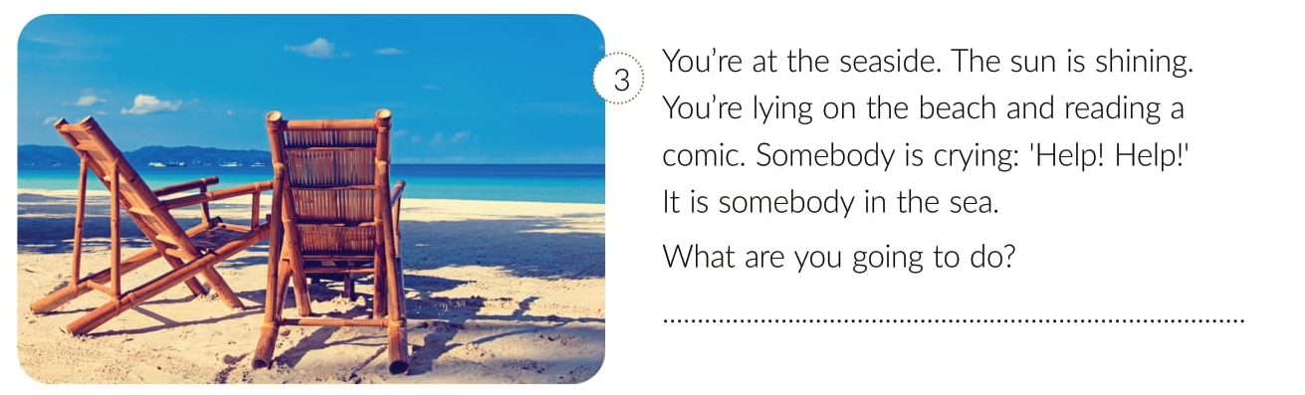
I am going to swim to them with a swim ring.

Slide 23
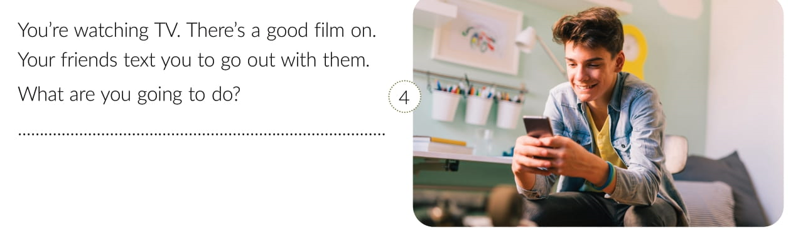
I am going to go out with them and record the film.

Slide 24
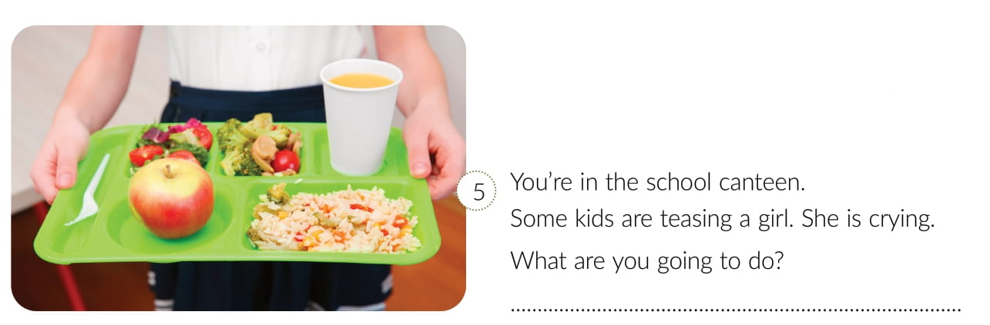
I am going to tell them to stop it.

Slide 25
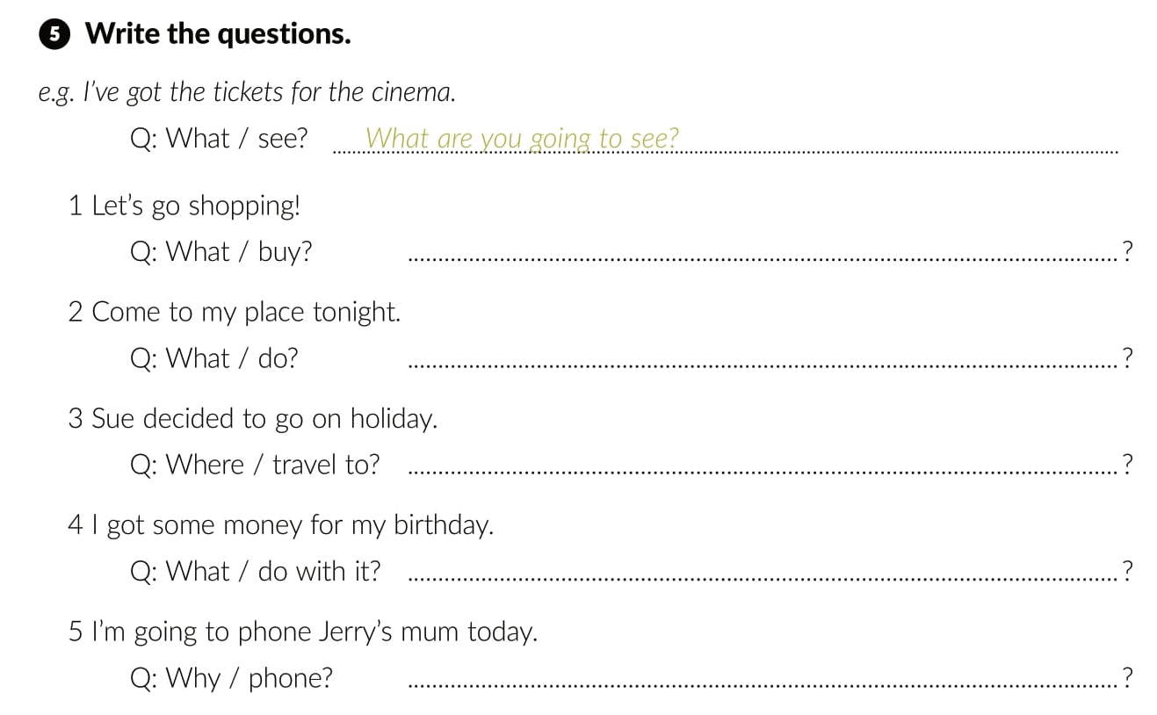
What are we going to buy?
What are we going to do?
Where is she going to travel?
What are we going to do with it?
Why are you going to phone her?

Slide 26
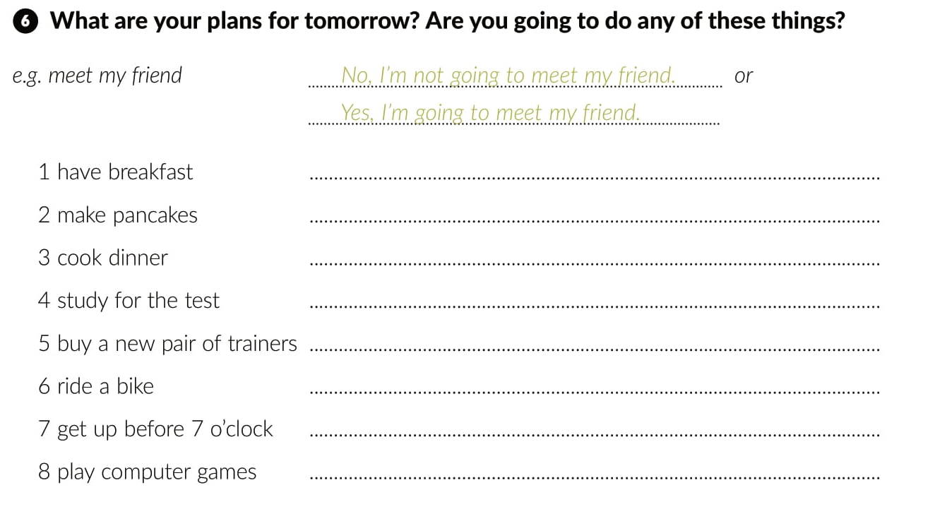

Slide 27
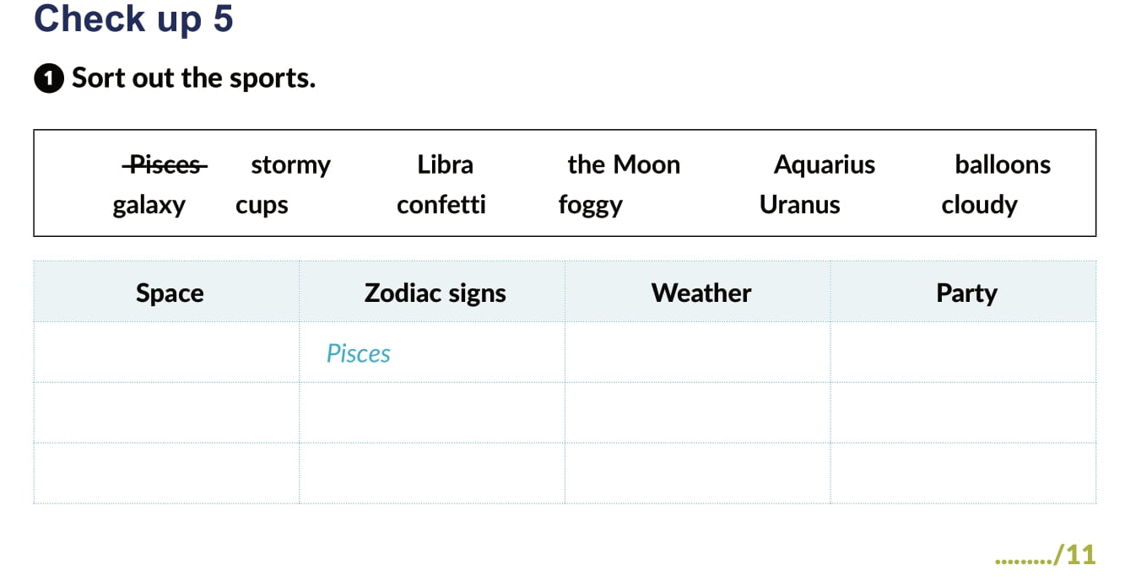
The Moon
stormy
balloons
galaxy
Libra
stormy
cups
Uranus
Aquarius
confetty
cloudy

Slide 28
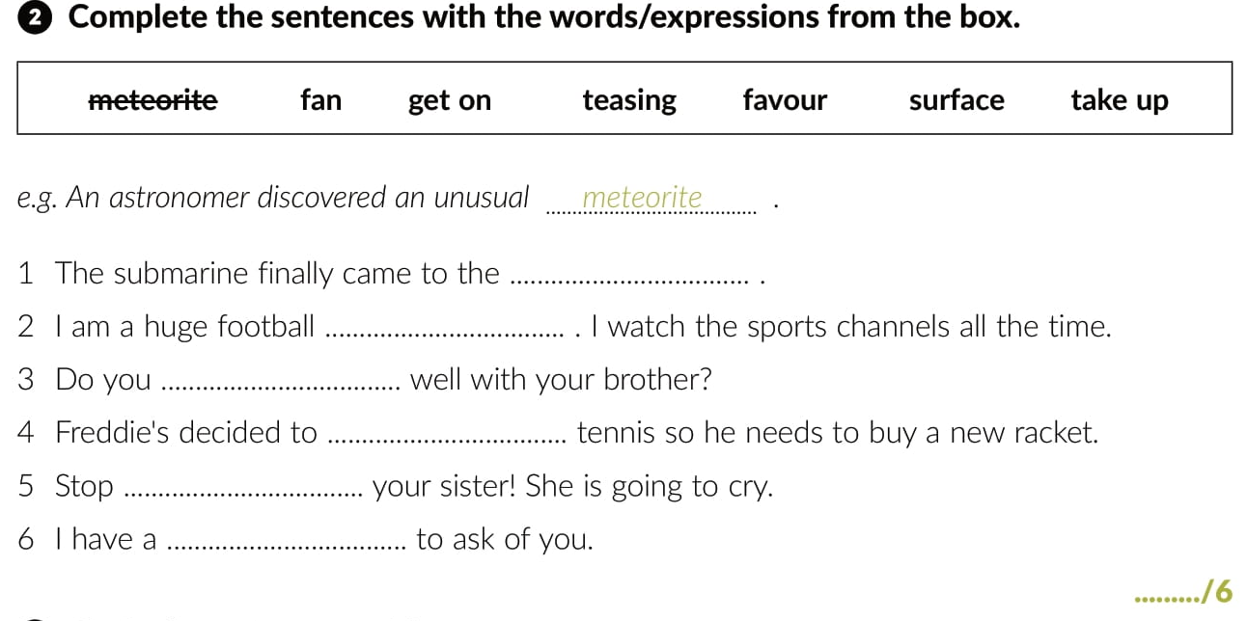
surface
fan
get on
take up
teasing
favour

Slide 29
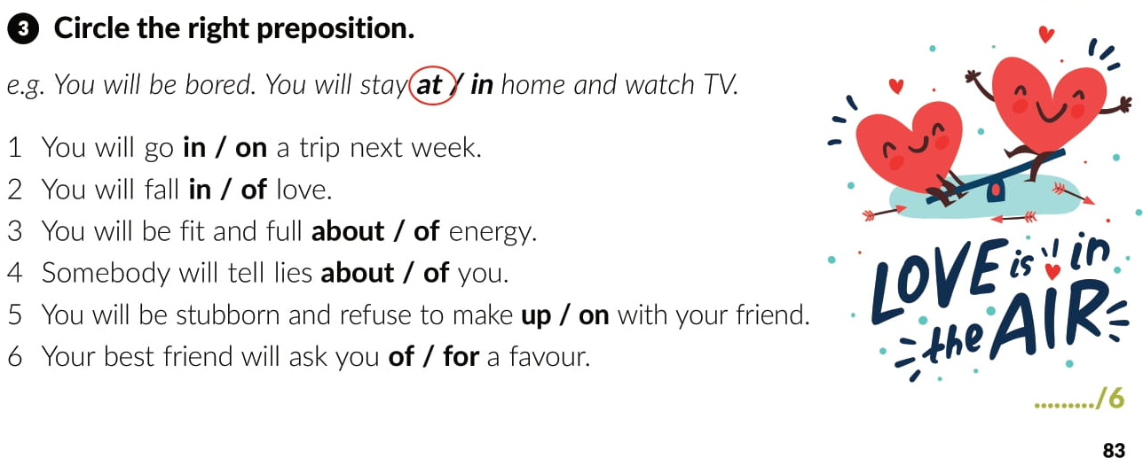

Slide 30
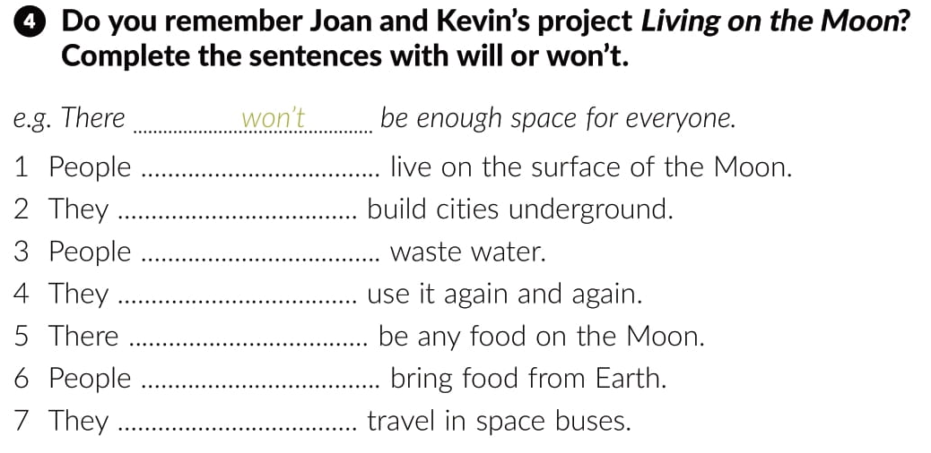

won’t
will
won’t
will
won’t
will
will

Slide 31
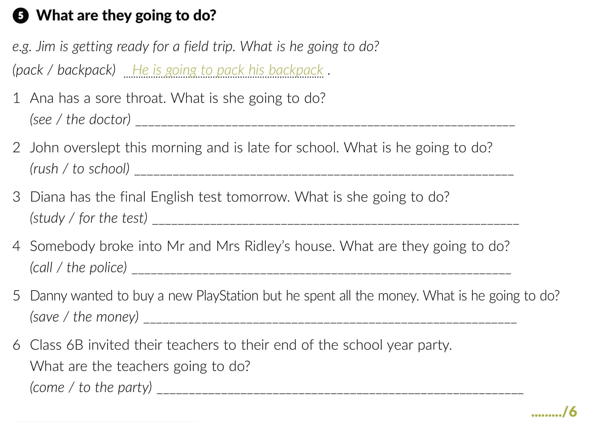


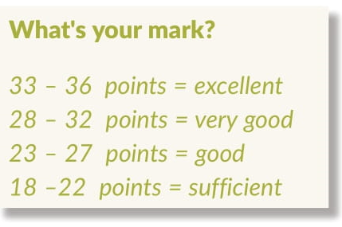
She is going to see the doctor.
He is going to rush to school.
She is going to study for the test.
They will call the police.
He is going to save the money.
They are going to come to the party.

Slide 32
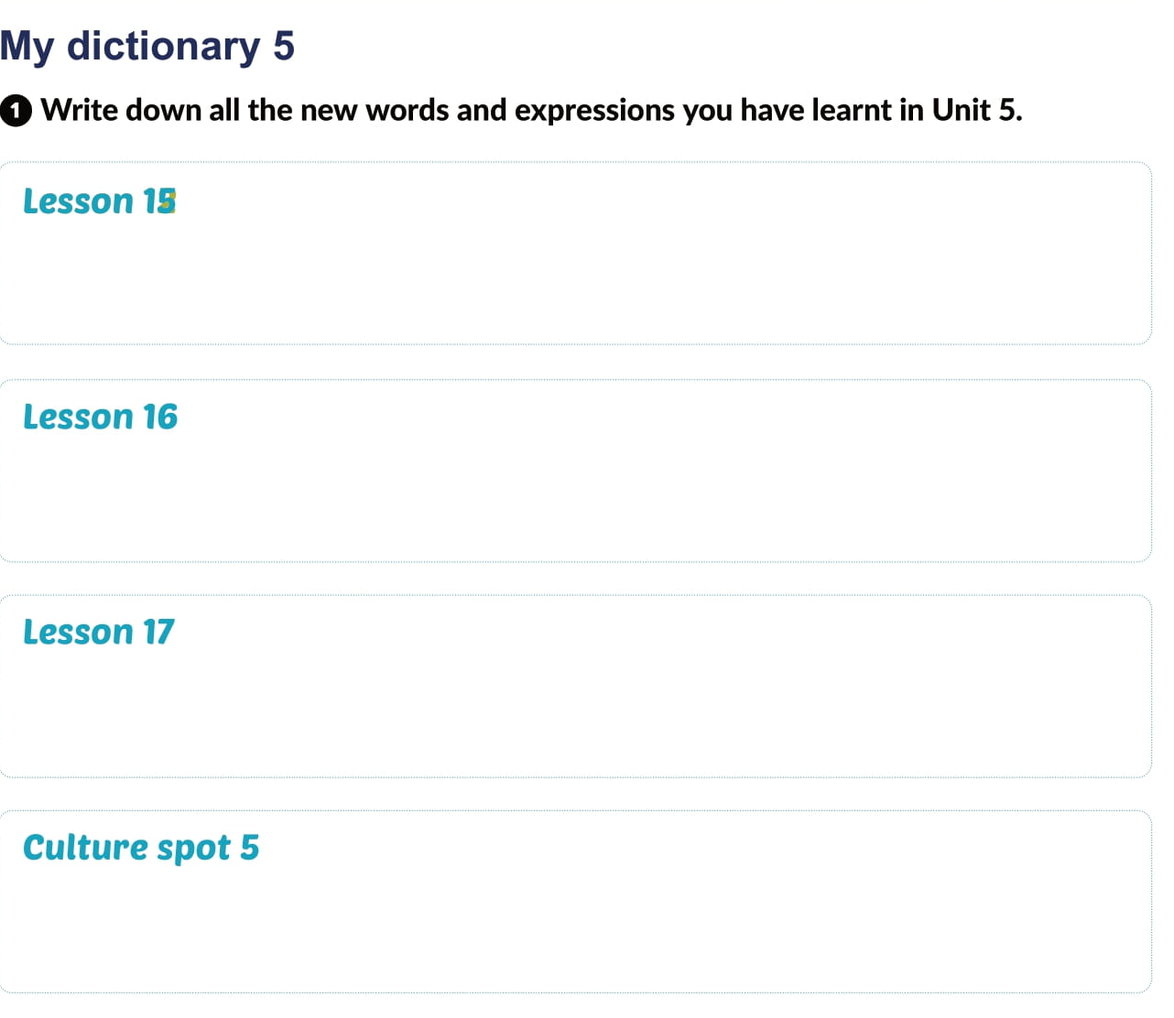

Slide 33
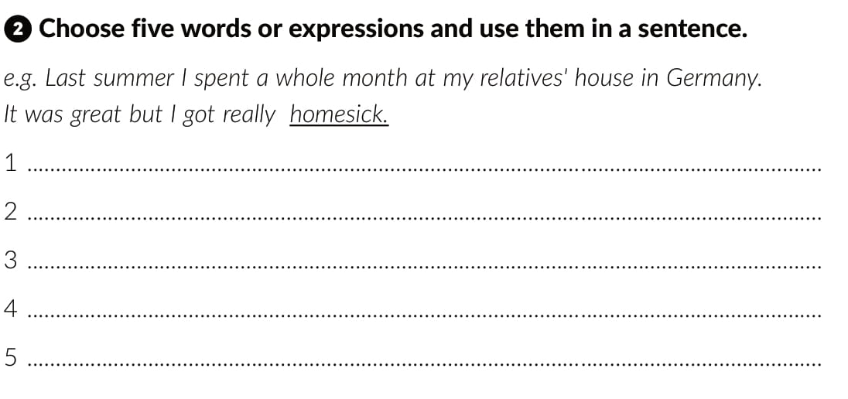

Slide 34
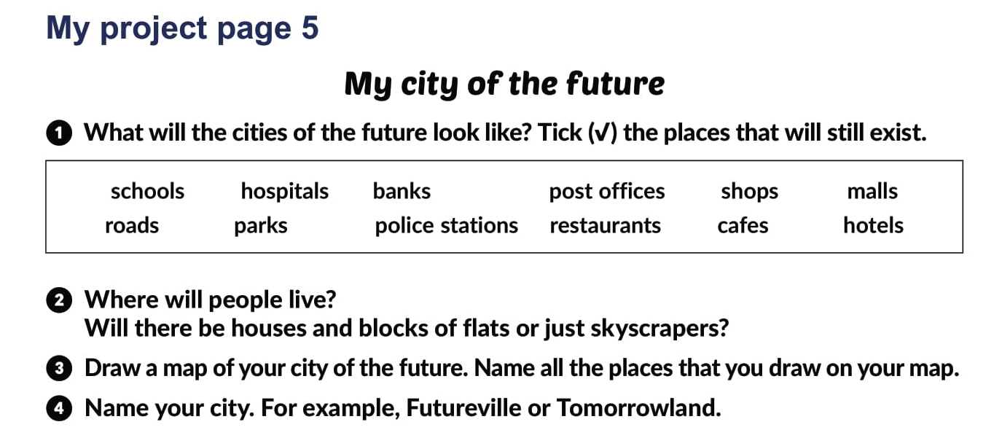

Slide 35
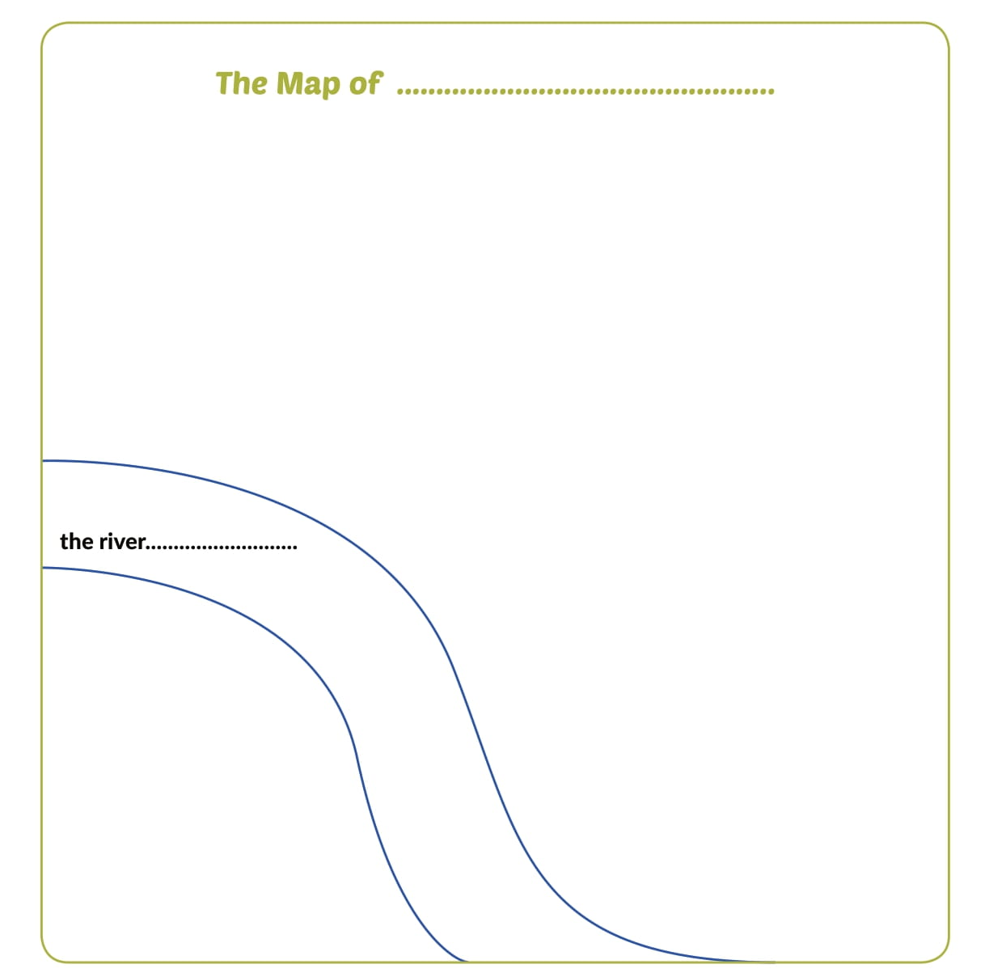

Slide 36

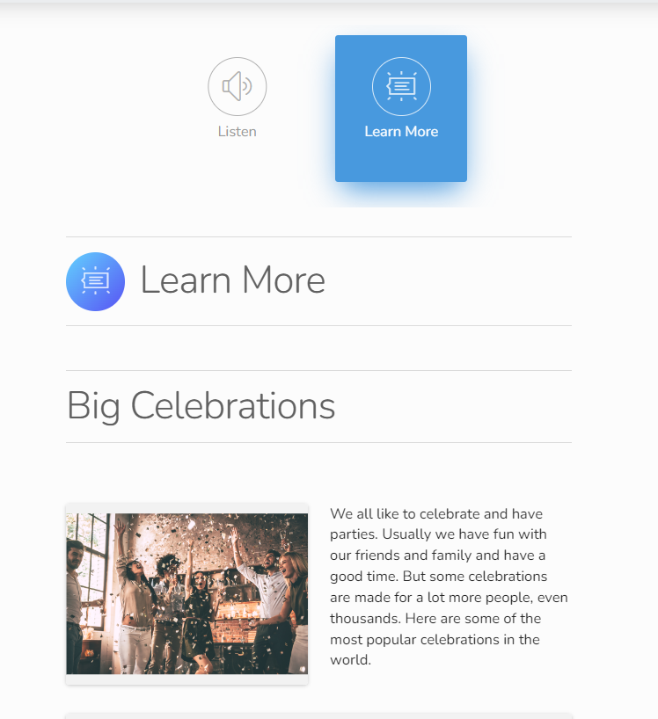
Otvori sljedeću poveznicu
Lesson 17 What a party | Way to go 3 (e-sfera.hr)

